Slide 1

BCT 421 :Professional Ethics and Practices in IT
Lesson Two: ICT Ethics

Slide 2

Investigating Ethical issues
Objectives
The objective of this class is to introduce current and prospective I.T. professionals to a procedure for analyzing ethical issues in your workplace.
When you have completed this class, you will be able to:
• Apply a procedure to systematically analyze an ethical issue,
• Conduct a dialectic to explore an ethical issue and reason about it,

Slide 3
Dialectic
Premise 1: We want to create attitudes, conventions, rules, and laws that encourage the development and use of I.T. for the good of us all. We do not want I.T. to serve the interests of a few, degrade our environment, etc.
Premise 2: In discussing computer ethical issues, we want to give reasons for our intuition and moral beliefs so arguments can be analyzed.
A dialectic (a dialogue from intuition per case, to argument based on principle, to theory) may not always lead to a definitive conclusion or a unanimous agreement, but it should increase knowledge and understanding.

Slide 4
Investigating Ethics
First we examine traditional ethical theories, concepts and analytic techniques. These establish a common vocabulary and framework which we can use to articulate moral ideas.

Slide 5
Investigative Procedure - Crime
Remember your favorite police shows, detective stories, thrillers and mystery books? Underneath the myriad plots is a fairly standard investigative procedure used by policing authorities to solve crimes generally:
recognize a crime may have occurred in a given situation
secure the crime scene
•collect evidence
identify the victim(s), suspects, witnesses, bystanders
collect statements
locate any party who departed the scene
explain the facts of what happened
formulate alternative hypotheses (theories) include motive and means for each possible perpetrator
eliminate suspects and hypotheses
charge most likely perpetrator(s)

Slide 6
Investigative Procedure - Ethics
Procedure to analyze an ethical issue:
recognize an ethical issue may exist in a given situation
• quarantine situation while under investigation
• collect evidence, eg. normative claims
2. identify the participants, stakeholders, victims,ie. identify the players or parties
• collect statements, documents
• notify any relevant external parties
3) explain the ethical problem faced by the players, ie. define the moral dilemma
4) formulate alternative solutions to the ethical problem, ie. list the options
• clarify the principles, values, outcomes underlying each solution
5) priorities the alternative solutions in terms of their values and outcomes, ie. state your preferred solution to the ethical problem.
• give a short rationale for your decision
• generalize where possible

Slide 7
EXAMPLE1
Jean, a statistical database programmer, is trying to write a large statistical program needed by her company. Programmers in this company are encouraged to write about their work and to publish their algorithms in professional journals. After months of tedious programming, Jean has found herself stuck on several parts of the program. Her manager, not recognising the complexity of the problem, wants the job completed within the next few days. Not knowing how to solve the problems, Jean remembers that a co-worker had given her source listings from his current work and from an early version of a commercial software package developed at another company. On studying these programs, she sees two areas of code which could be directly incorporated into her own program. She uses segments of code from both her co-worker and the commercial software, but does not tell anyone or mention it in the documentation. She completes the project and turns it in a day ahead of time.

Slide 8
EXAMPLE2
A software development company has just produced a new software package that incorporates the new tax laws and figures taxes for both individuals and small businesses. The president of the company knows that the program has a number of bugs. He also believes the first firm to put this kind of software on the market is likely to capture the largest market share. The company widely advertises the program.
When the company actually ships a CD, it includes a disclaimer of responsibility for errors resulting from the use of the program. The company expects it will receive a number of complaints, queries, and suggestions for modification. The company plans to use these to make changes and eventually issue updated, improved, and debugged versions. The president argues that this is general industry policy and that anyone who buys version 1.0 of a program knows this and will take proper precautions. Because of bugs, a number of users filed incorrect tax returns and were penalised by the KRA

Slide 9
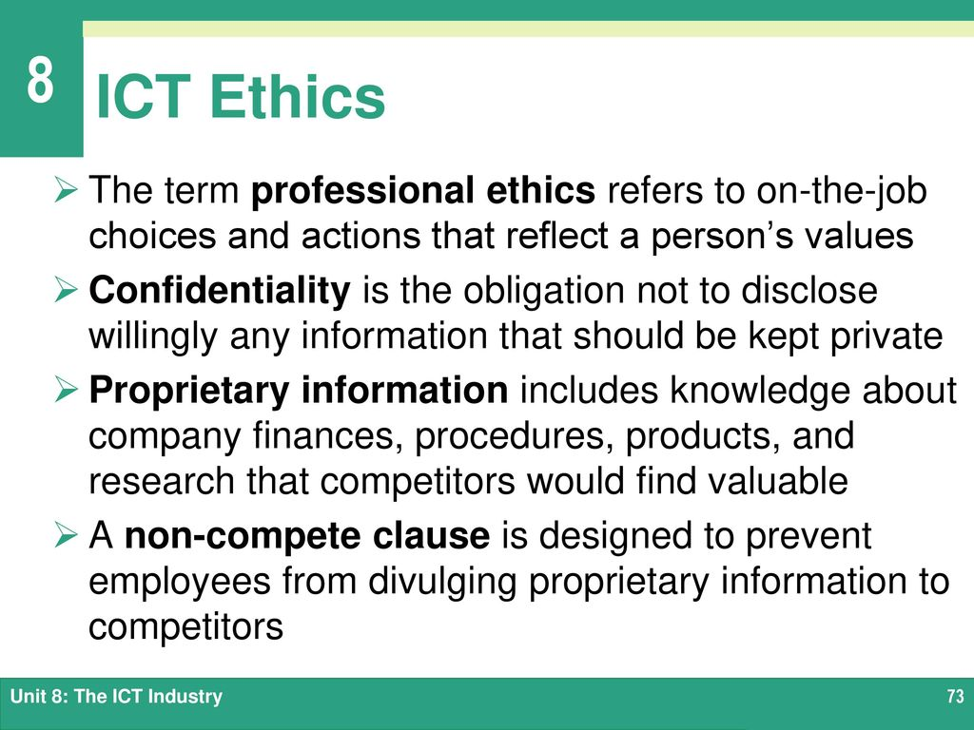

Slide 10
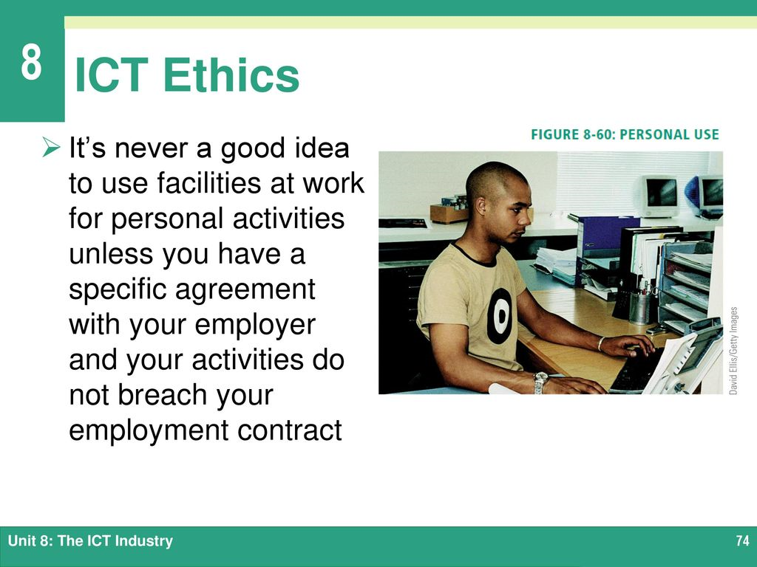

Slide 11
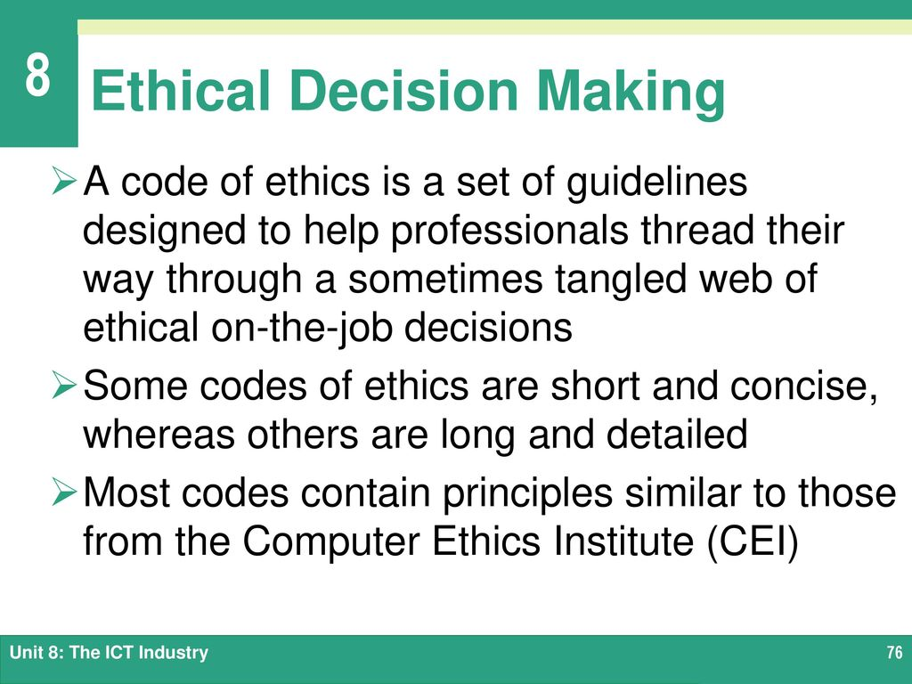

Slide 12
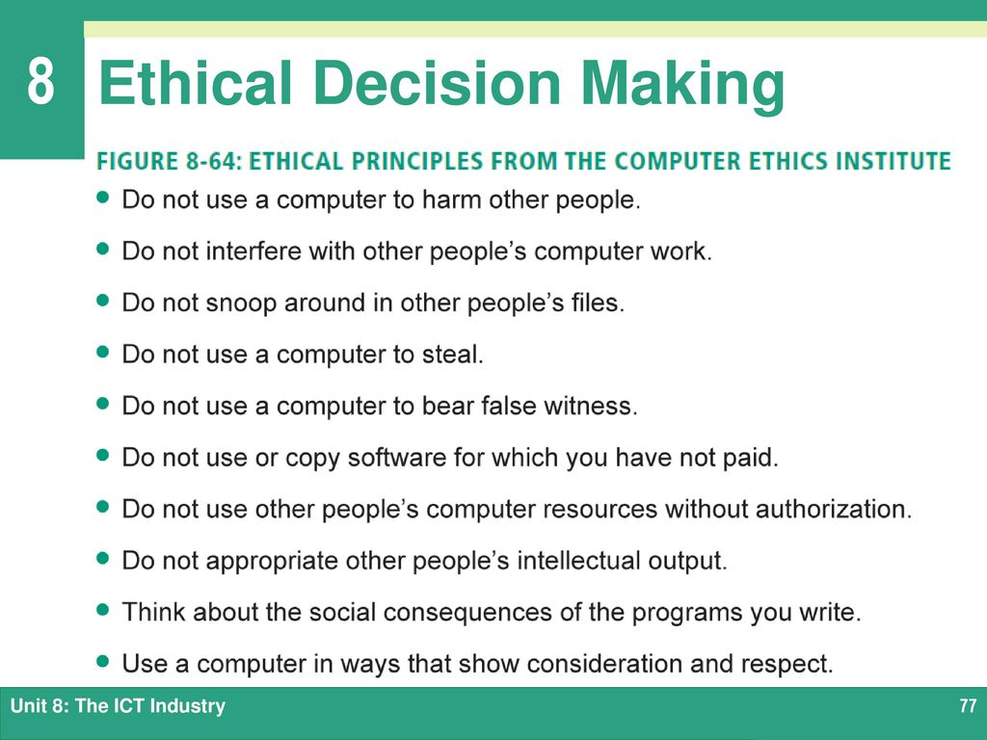

Slide 13
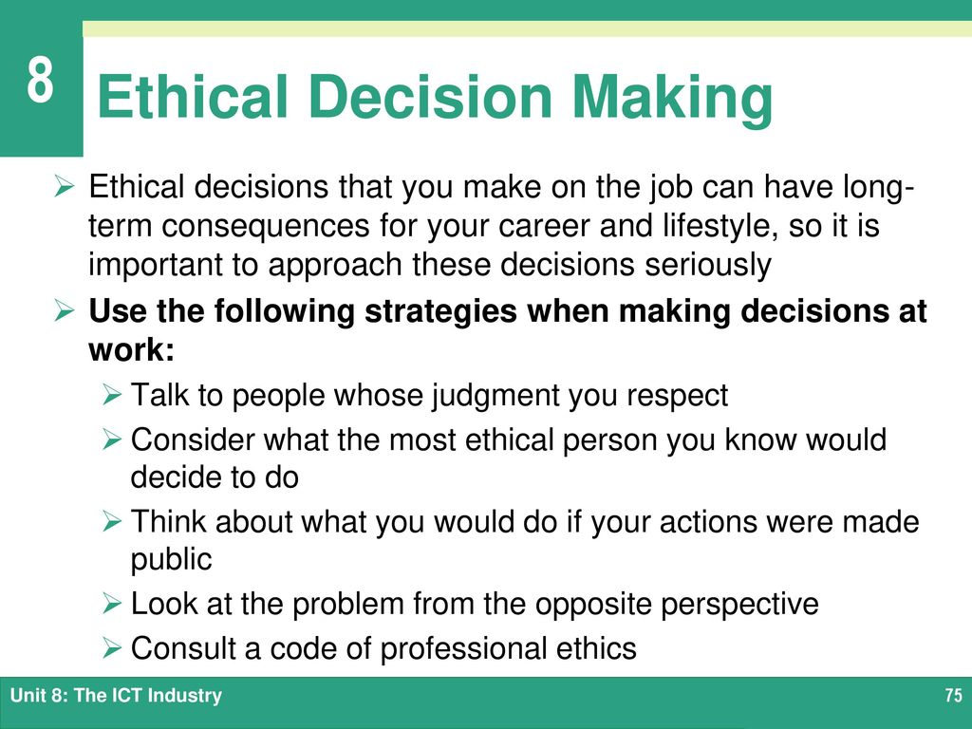

Slide 14
Philosophical Ethics
Objectives
The objective of this class is to introduce current and prospective I.T. professionals to three (3) major ethical theories: relativism, utilitarianism and deontology.
We cannot possibly do justice to over two thousand years of intellectual effort behind these theories. But we can expand the ethical procedure introduced in earlier to include the reasoning power of an ethical theory when it can support a dialectic.
When you have completed this class, you will be able to:
• Explain 3 ethical theories: relativism, utilitarianism and deontology,
• Apply a procedure to systematically analyze an ethical issue with the support of an ethical theory

Slide 15
Relativism
Is what is right for me necessarily right for you? Is ethics relative …to the individual or society?
Relativism can be formulated as :
a) There are no universal rights and wrongs, and
b) right and wrong are relative to one's society.

Slide 16
Relativism
Descriptive facts cited as supporting relativism
1) What is considered right and wrong varies between cultures. Eg. Wife inheritance, gay
2) What is considered right/wrong at one time in a society may change. Eg. slavery.
3) The morals we are taught depend on our religion / environment.

Slide 17
Utilitarianism
…is a form of consequentialism which evaluates behavior in terms of consequences.
Utility principle: Everyone ought to act so as to bring about the greatest amount of happiness for the greatest number of people.
(Cf. Egoism: You ought to act so as to bring about the most good consequences for yourself)
Argument in support of utilitarianism:
Happiness is the ultimate intrinsic good =>
Morality must be based on creating as much of this good as possible =>
The right action is the one that produces the most overall net happiness (good minus bad).

Slide 18
Analysis of Utilitarianism
According to utilitarianism, no one person's un/happiness is more important than another's.
Since great overall happiness may result from sacrificing the happiness of a few, utilitarianism appears to justify imposing enormous burdens on some individuals for the sake of others.

Slide 19
Deontology
Deontology = duty science (in Greek etymology)
…an ethical theory that states "at least some acts are morally obligatory regardless of their consequences for human welfare".
What makes an action right or wrong? For utilitarians, it is the consequences. For deontologists, it is the principle behind the act.

Slide 20
Deontology
Eg. It is not morally worthy to tell the truth because a reward is expected, or punishment for lying is feared. It is right to tell the truth because
I accept I must respect the other person.
Argument in support of deontology:
If happiness is the highest good, blind instinct would suit us better than our unique rationality which lets us reason, decide & act.
Animals cannot be moral beings because they lack the rationality that allows us to be moral.
We must not deny a person's rationality.
Hence the categorical imperative (C.I.) :
Never treat another person merely as a means; always respect individuals as ends in themselves.

Slide 21
Christian Virtue Ethics
The virtue of Christian Compassion in Medicine emphasized “suffering with the patient”
At this point in time there were two schools of Medicine, naturalistic and religious
Notes:
By the 4th century Christian philosophy began to influence the theory of health care.
The paradigmatic virtue of compassion (charity) that many today associate with a good physician comes in part from Christianity’s emphasis on helping others.
Naturalistic physicians emphasized technical competence in curing disease while religious physicians emphasized compassion in being with patients. Because the limits of medicine were usually reached fairly quickly in Medieval Europe, compassion became the paramount virtue.

Slide 22
Natural Law Theory
“What is…ought to be.”
Thomas Aquinas in the 11th century said that a rational god made the world work rationally and gave humans the ability to discover his rationale
Notes:
From Natural Law Theory we get the famous “Doctrine of Double Effect”

Slide 23
Doctrine of Double Effect
If an action has two effects, one good and the other evil, the action is morally permissible
If there was a good intention
If the good happened at exactly the same time as the evil
If only the Good was actually intended
If there was an important enough reason for performing the action and risking the evil outcome

Slide 24
Social Contract Theory
Assumes that people are fundamentally self-interested and that moral rules have evolved for humans to get along with one another.
Notes:
If we didn’t have social contractarianism we would pick each other apart like animals.

Slide 25
Kantian Ethics
A right act always treats other humans as end-in-themselves, never as a mere means

Slide 26
Utilitarianism
Right acts produce the greatest amount of good for the greatest number of people
Four Tenets
Consequentialism
The Maximization Principle
A Theory of Value
A scope-of-morality premise
Notes:
Consequentialism - consequences count, not motives or intentions
The Maximization Principles - The number of people affected by consequences matters, the more people, the more important the effect
A Theroy of Value - Good consequences are defined by pleasure (hedonic utilitarianism) or what people prefer (preference utilitarianism).
A scope-of-morality premise - Each being’s happiness is to count as one and no more

Slide 27
Case-Based Reasoning
Also known as Casuistry
Analyzes cases by comparing them to other cases rather than using philosophical principles
Also looks at each case as a unique situation and not a precedent

Slide 28
Pragmatism
Whatever methods has the best outcome is the best way to go

Slide 29
Exercise
Is ethical relativism convincing, credible, plausible ?
Why can't happiness be the highest good for humans, according to deontologists ?

Slide 30
END
NEXT LECTURE CODES OF ETHICS

